Slide 1
The cfa Charter
Julan Al-Yassin, CFA
Education Chair, CFA Society Dayton
13 November 2020
Notes:
[Presenter’s Note: Welcome to the Professor’s Presentation, which you can use to introduce your students to the CFA Program and to CFA Institute. If you have any questions, please don’t hesitate to contact us at university@cfainstitute.org.]
Hello, I’m _______. Thank you for having me here. It’s my hope that after today you’ll have a better understanding of the CFA charter and what an important role it can play in your future.

Slide 2

WHAT IS THE CFA CHARTER?
Since 1963, the CFA (Chartered Financial Analyst)
Charter has been recognized as the top globally recognized investment credential since 1963
Deemed the “gold standard” by industry leaders and employers
A designation held by over 90,000 investment professionals in more than 135 countries
Top employers
    Regulators in 19 countries recognize the charter as a proxy for certain licenses
If you’re looking for a passport to the world of investment and finance, earning the CFA charter could be the most important move you make in your career.
Notes:
If you are looking for a passport to the world of finance and investing, then earning the CFA® charter could be the most important move you make in your career.

Slide 3
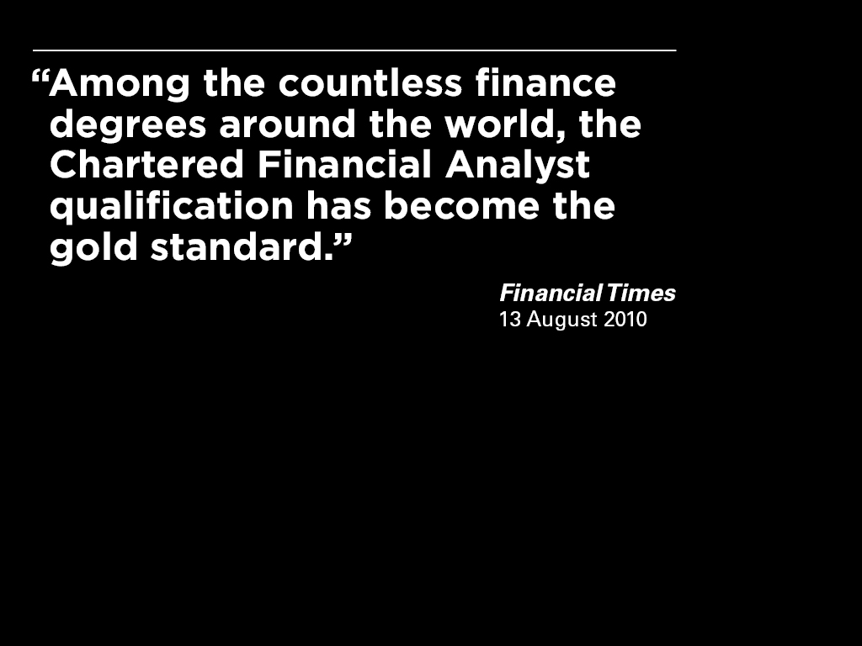

Notes:
What is the CFA charter?
Since it was first introduced in 1963, the CFA charter has become the most widely known and well respected investment credential in the world.
Today, publications such as the Financial Times—and the investment industry as a whole—recognize the CFA charter as the gold standard in investment management and finance, the definitive mark by which to measure the competence, integrity, and dedication of serious investment professionals.
The Financial Times has also called the CFA credential the industry benchmark because the program is built around a robust curriculum that is practice driven. To ensure that the Program is grounded in practice, we engage practicing CFA Charterholders from around the world at every stage of curriculum development, exam development, exam grading, and even the process for setting minimum passing scores.

Slide 4
The cfa charter
  Graduate-level investment credential
  Held by more than 168,000 individuals in 166 countries
  Recognized by regulatory bodies in many countries as a proxy for meeting certain licensing requirements
  More than 630 universities around the world incorporate the CFA curriculum into their degree programs
Notes:
The CFA charter is a globally recognized graduate-level credential that bridges academic theory, current industry practice, and ethical and professional standards to give you a strong foundation of advanced investment analysis and real-world portfolio management skills.
It is held by more than 168,000 investment professionals working in more than 166 countries, and is increasingly recognized as comparable to a variety of degrees, credentials, and licenses around the world. For example, the United Kingdom National Academic Recognition Information Centre benchmarked the CFA Program as comparable to a master’s degree.
Additionally, today more than 630 universities around the world incorporate the CFA curriculum into their degree programs.

Slide 5
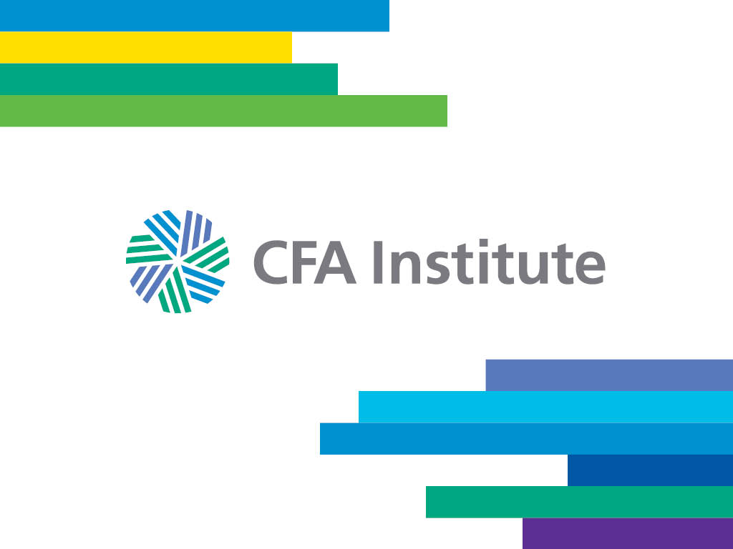
Notes:
The CFA Charter is offered by CFA Institute, a global association of more than 145,000 investment professionals.
By setting the highest educational standards and extending its real-world educational content to an ever-widening population through its globally respected credentials and educational programs, CFA Institute fulfills its mission to serve as a leading source for practice-based knowledge, advanced skills, and ethical practices throughout the investment industry, and helps to create an environment where investors’ interests come first, markets function at their best, and economies grow.
In addition to administering the CFA Program, CFA Institute provides other educational opportunities including the CIPM® certification and the CFA Institute Investment Foundations™ certificate.

Slide 6
Growing demand for the cfa charter
Candidate exam registration
Notes:
So, what’s behind all this demand?
Simply put, no other investment designation carries the same global prestige as the CFA charter.

Slide 7
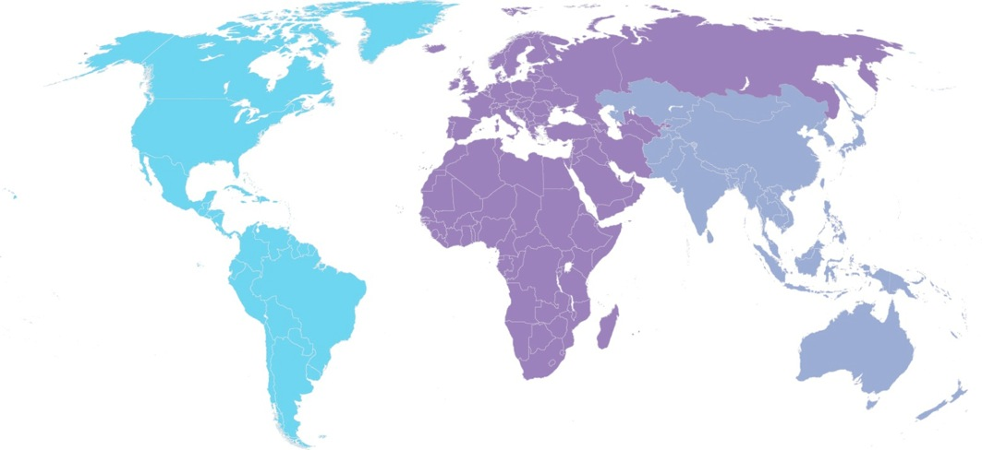
Membership, candidates & societies
More than
176,000
members
in 166
countries;
159 member
societies
AMERICAS
Members: 102,713
CFA Program
Registrations: 90,985
Societies: 92
EMEA
Members: 39,596
CFA Program
Registrations: 63,046
Societies: 45
ASIA PACIFIC
Members: 34,352
CFA Program
Registrations: 200,762
Societies: 22

Slide 8
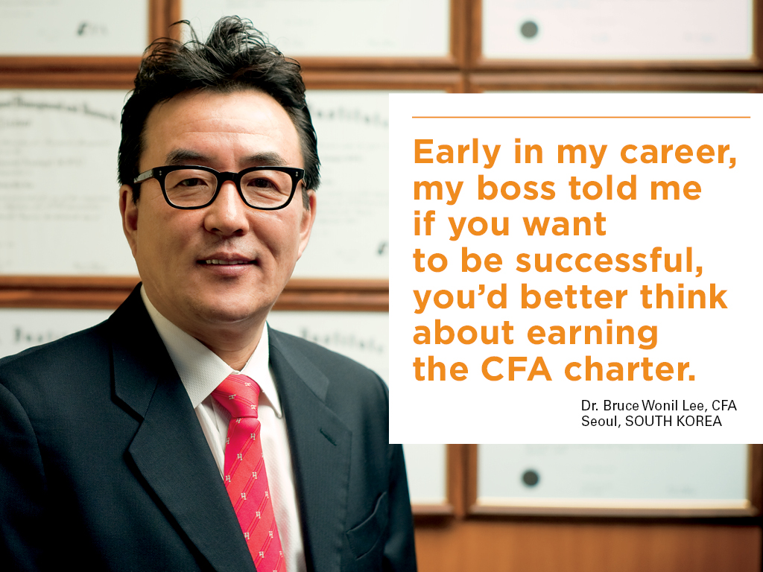
Notes:
Employers increasingly recognize the value of the CFA charter and the difficulty of earning it.
As a result, they see the charter as a prerequisite for employment in a wide range of investment and finance positions.
For them, it’s a guarantee that you’ve mastered the skills most needed in today’s fast-evolving workplace. It’s also a clear signal of your commitment to upholding the highest standards and your ability to work in any market.

Slide 9
Employers seek out the cfa charter
  “Enrollment in or completion of a CFA designation [program] would be an asset”
  -Investment Banking Analyst, Goldman Sachs, 2010
  “You have, or are in the final year of [earning] , your CFA designation”
  -Equity Research Associate, Bank of America Merrill Lynch, 2010
  “Completed [the CFA Program] or working towards CFA designation is advantageous”
  - Analyst, BlackRock, 2010
* Listings from CFA Institute JobLine
Notes:
More and more often, the charter is featured in financial job advertisements such as these, in which some of the industry’s top employers—like Goldman Sachs, Bank of America Merrill Lynch, BlackRock—call for the CFA charter or progress toward it.
As these ads attest, employers such as these recognize the CFA charter as the most reliable way for differentiating the most skilled and qualified job applicants.

Slide 10
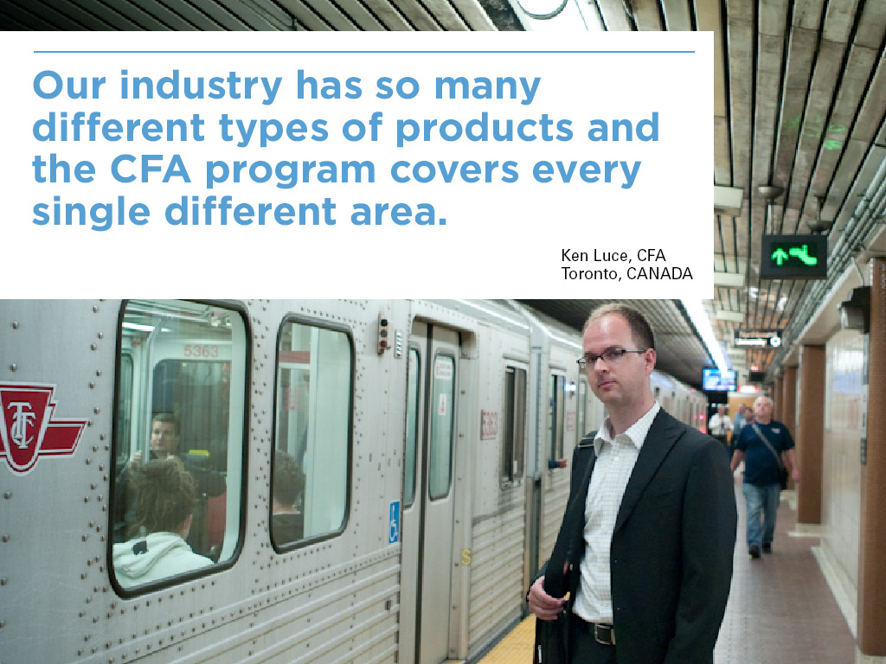
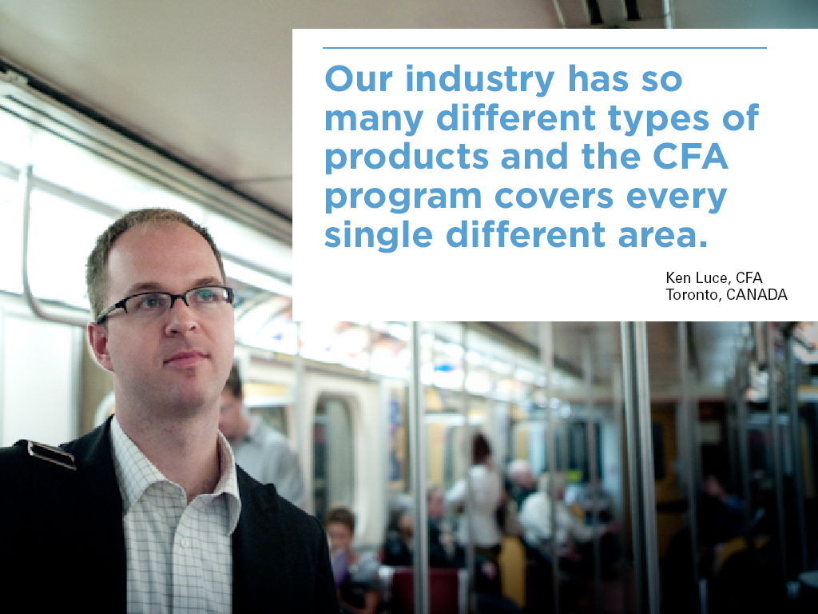
Notes:
Now let’s look a little more closely at the range of knowledge and skills you gain as a CFA charterholder that is so attractive to employers.

Slide 11
What you learn as a cfa charterholder
Investment (equity and fixed income) analysis
Portfolio management
Wealth planning
Economic theory
Alternatives and derivatives
Performance measurement & evaluation
Risk management
Financial reporting
Quantitative methods
Notes:
The comprehensive CFA Program curriculum is organized into 10 general topic areas that provide a framework of important skills needed for making sound investment decisions.
All of these topics are grounded in the real world of the investment profession and are regularly updated through a practice-analysis process that draws on the specialized knowledge of active practitioners, employers, and current CFA Charterholders.
Ethics and professional standards are emphasized throughout the program because…(next slide)
[Note to presenter: elaborate on topics if you wish.]

Slide 12

Notes:
Best practices of ethics and professional conduct in the financial industry are at the root of the curriculum, the exam, and CFA Institute.
Throughout your studies, you will learn best practices for ethical professional behavior specifically applied to situations you will encounter in the workplace. This helps ensure that charterholders serve as active stewards of the integrity of the investment industry, where reputation is everything and where trust, transparency, and investor protection are critical.

Slide 13
THREE LEVELS OF CFA program EXAMS
Notes:
The course of study itself is organized into three levels, each culminating in a six-hour exam. Each of the three exams covers a full range of topics, but with a different focus. Designed to correspond to job requirements at each stage of your career.
As a result, each level of the CFA exam differs not only in the type of questions asked, but in the subject material covered and the nature of the response required. As you begin your career in investment management, you will likely be an equity analyst or assistant portfolio manager. At that career stage, senior colleagues will ask you to use basic investment tools and perform calculations.
The Level I curriculum and examination, often taken by junior professionals, devotes a large share of its content to investment tools, shown here in green. Knowledge of asset classes and portfolio management constitute less of both the curriculum and exam at Level I. The Level I exam focuses on the candidate’s knowledge and comprehension. 240 MC questions.
In Level II, the candidate is maturing and growing. Now your work focuses less on the use of basic tools and more on the nature of the assets to be analyzed. At this Level, the curriculum and the examination devote more attention to the nature of asset classes. The Level II exam requires candidates to apply and analyze. 20 Item Sets → Richer analysis and mode of evaluation.
Level III reflects the requirements of a seasoned professional, someone whose title might be director of research or portfolio manager. The majority of the examination is devoted to portfolio management, both in institutional and individual contexts. The Level III examination calls on candidates to synthesize and evaluate. 10-15 Essays; 10 Item Sets → Opportunity to demonstrate synthesis and extension.
ETHICS IS THE CORE: At all 3 levels of the CFA Program, the core of the curriculum and the examinations is Ethics and Professional Standards (symbolized here by the light blue square). You will learn best practices for ethical professional behavior specifically applied to situations you will encounter in a variety of investment and financial settings.

Slide 14
What can I do with the cfa charter?
Charterholder employment by primary investment practice
.
Notes:
As you can see from this graph, CFA charterholders can be found in virtually every sector of the financial markets because with a curriculum this broad and thorough, there is no limit to the types of work you are qualified to do.
Charterholders may focus on equities, fixed income securities, private equity, hedge funds, venture capital, derivatives, commodities, real estate or currencies, to name some of the most common. Or they may manage portfolios containing some or all of those asset classes.

Slide 15
What can I do with the cfa charter?
Charterholder employment by title
Notes:
Here’s another look at where the charter can take you, broken out by title.
You’ll notice that many of our members do not fit into these standard categories. Some charterholders work as traders, brokers, academics, regulators and many other roles that require advanced investment skills.
The charter also equips charterholders to change specialties as their careers evolve, by demonstrating the dedication, credibility, and breadth of knowledge needed to advance into many senior management roles and even into positions in companies outside of the investment industry.

Slide 16
TOP GLOBAL EMPLOYERS OF CHARTERHOLDERS
Bank of America Merrill Lynch
BlackRock
Citigroup
Credit Suisse
HSBC
JP Morgan Chase
Morgan Stanley Smith Barney
RBC
UBS
Wells Fargo
Notes:
Here you can see a quick snapshot of some of the top global employers of CFA charterholders.
These include nearly all the world’s leading financial institutions, including the big investment banks such as Bank of America Merrill Lynch, Citigroup, and JPMorgan, as well as asset management firms, insurance companies, and accounting firms.

Slide 17
The cfa equation
Bachelor’s degree or in final year of bachelor’s
Level I, II, III Exams
CFA Charter
4 years work experience
Notes:
So how do you go about earning the charter? We broke it down into a simple formula. To initially enroll as a CFA candidate, you must:
hold a bachelor's degree in any subject; or
be in the final year of your bachelor’s degree program at the time of registration; or
have four years of qualified, professional work experience; or
a combination of work and study that totals at least four years.
You must pass the three levels of exams held in over 180 locations around the world. Level I exams are held in June and December. Levels II and III are held in June. After enrolling, candidates must demonstrate at least four cumulative years of relevant work experience, at least 50% of which involves investment decision-making. This experience can be accrued before, after, or during the time you are studying for and taking the exams.
The entire CFA Program can be accomplished in as few as two years, but many candidates schedule their exams around work and family commitments. Successful candidates report spending an average of 300 hours preparing for each exam, and it takes most candidates between two and five years to complete the entire program.
However, you may take as long as you need to complete the CFA Program. Your exam results never expire, and we don’t limit the number of times you can sit for each exam level.

Slide 18
Computer-Based Testing Information
CFA Institute is transitioning all CFA exams to computer-based testing. The December 2020 exam is the last paper-based exam; exams in 2021 will be computer-based for all levels.
Candidates self-schedule exam appointments. The length of each exam window will be up to ten days long.
Exams will be delivered in proctored exam centers with robust security measures in place.
We are increasing the number of testing locations under CBT.
Exam duration has been shortened in CBT.
Candidates will not be able to register for adjacent windows. For example, a Level I candidates who takes the February 2021 administration and does not pass may not sit again until the August administration.

Slide 19
Exam Format Change
CFA Program CBT exams will consist of fewer questions resulting in a proportional reduction in testing time.
Each exam appointment will include:
  30 minutes allotted to pledge, tutorial, and survey
  135 minutes for session 1
  30 minutes for optional break
  135 minutes for session 2
  Total testing time is 4.5 hours
  Total appointment time is 5.5 hours

Slide 20
ENROLLMENT DETAILS
The Cost of December 2020 CFA Program exams
One-Time Initial Program Enrollment Fee US$ 450
(Level I only)
Early Registration Fee US$ 700
(ended 25 March 2020)
Standard Registration Fee US$ 1,000
(ends 19 August 2020)
Late Registration Fee US$ 1,450
(ends 9 September 2020)
*Fees vary depending on the deadline by which enrollment and/or registration is completed and by the curriculum format that is chosen.
Notes:
The cost of completing the entire CFA Program averages approximately $2,400, which compares very favorably to other educational and training options.
As anyone will tell you, mastering this broad curriculum and completing the charter is no small feat. The real cost of the CFA program is the time and energy that candidates commit to the program to be successful.

Slide 21
Scholarships
Access Scholarship
Awarded by the CFA Society Dayton
Program enrolment fee is waived, and exam registration fee is reduced to USD 350.
Student Scholarship
Awarded by CFAI Affiliated Universities
Waive the CFA Program enrolment fee and reduce the exam registration fee (includes access to the curriculum eBook) to USD 250

Slide 22
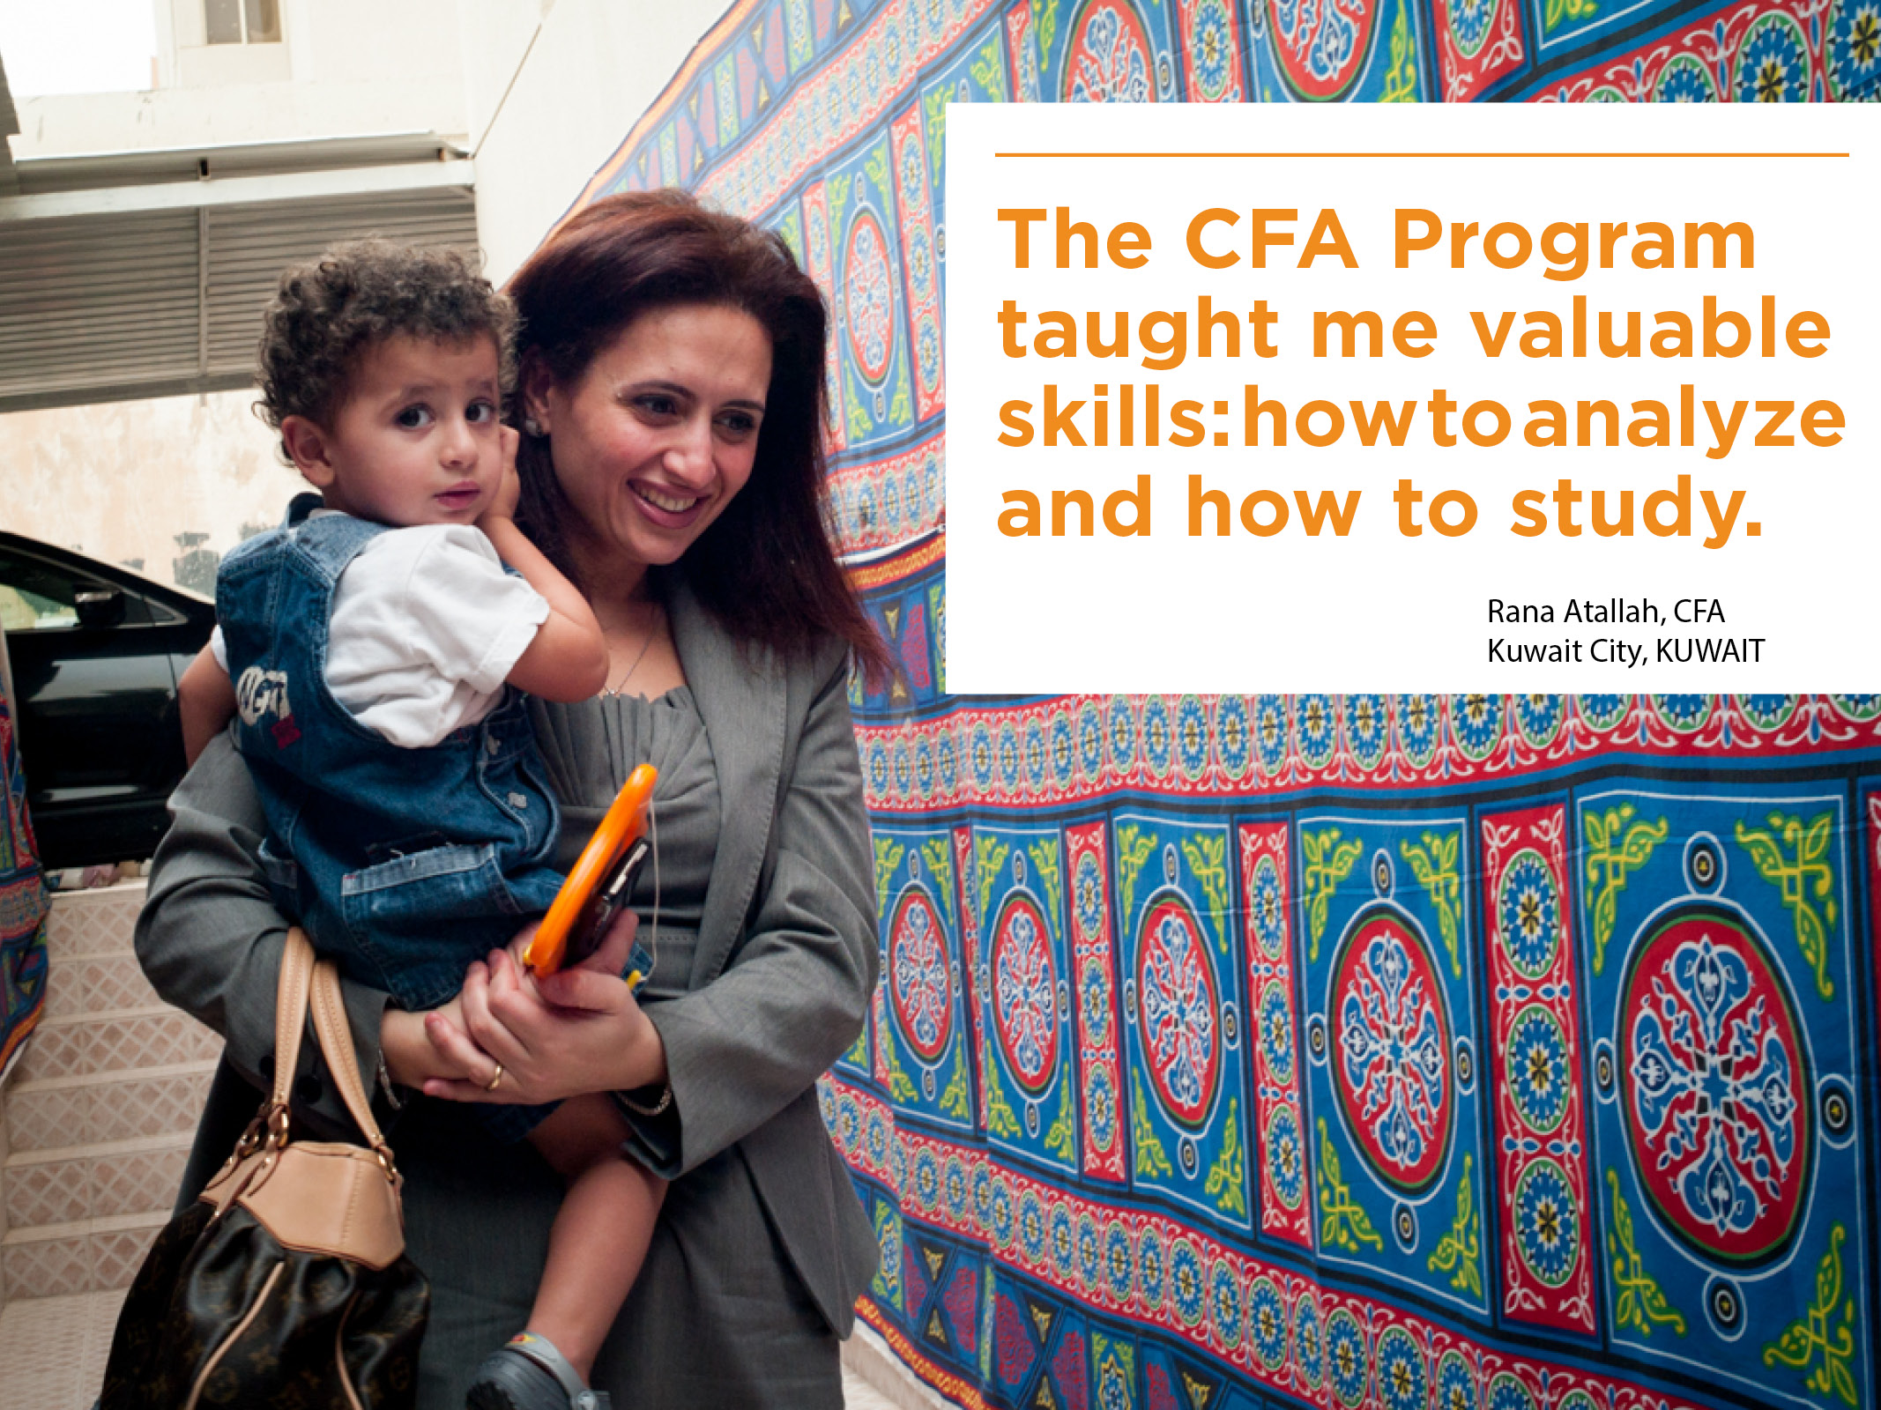
Notes:
Although the process is time consuming, the course of study is offered in a self-study learning format, which means that earning it does not have to completely disrupt your professional or personal life.
All the curriculum materials are provided to you either in the mail, online as downloads, or both. So you can complete the program wherever you are, whenever you want, and in the format most convenient and effective for you.

Slide 23
WITH THE CFA CHARTER, YOU …
  Develop a comprehensive investment perspective
  Gain fluency in practical investment analysis and management skills
  Earn credibility with industry peers
  Become part of a global community of top industry professionals
  Gain the flexibility to work in any market
  Are sought out by top industry employers
  Demonstrate a commitment to ethics and professional standards
Notes:
In summary, if you are considering a career in the investment industry, making the decision to earn the CFA charter will change the course of your career. Whether or not you pursue the CFA charter, I hope you make a commitment to upholding the highest standards of ethics, education, and professional excellence for the ultimate benefit of society because, as the last few years have shown us, veering from these carries severe social and economic consequences.
If you decide to you earn the CFA charter, you
Develop a comprehensive investment perspective;
Gain fluency with practical investment analysis and investment management skills;
Have credibility with industry peers and are respected by employers and clients;
Earn credibility with industry peers
Have the flexibility to work in any global market;
Are sought out by top industry employers who see that you have the professional motivation and the work ethic required to complete the program;
And you have demonstrated a commitment to ethics and high professional standards.

Slide 24
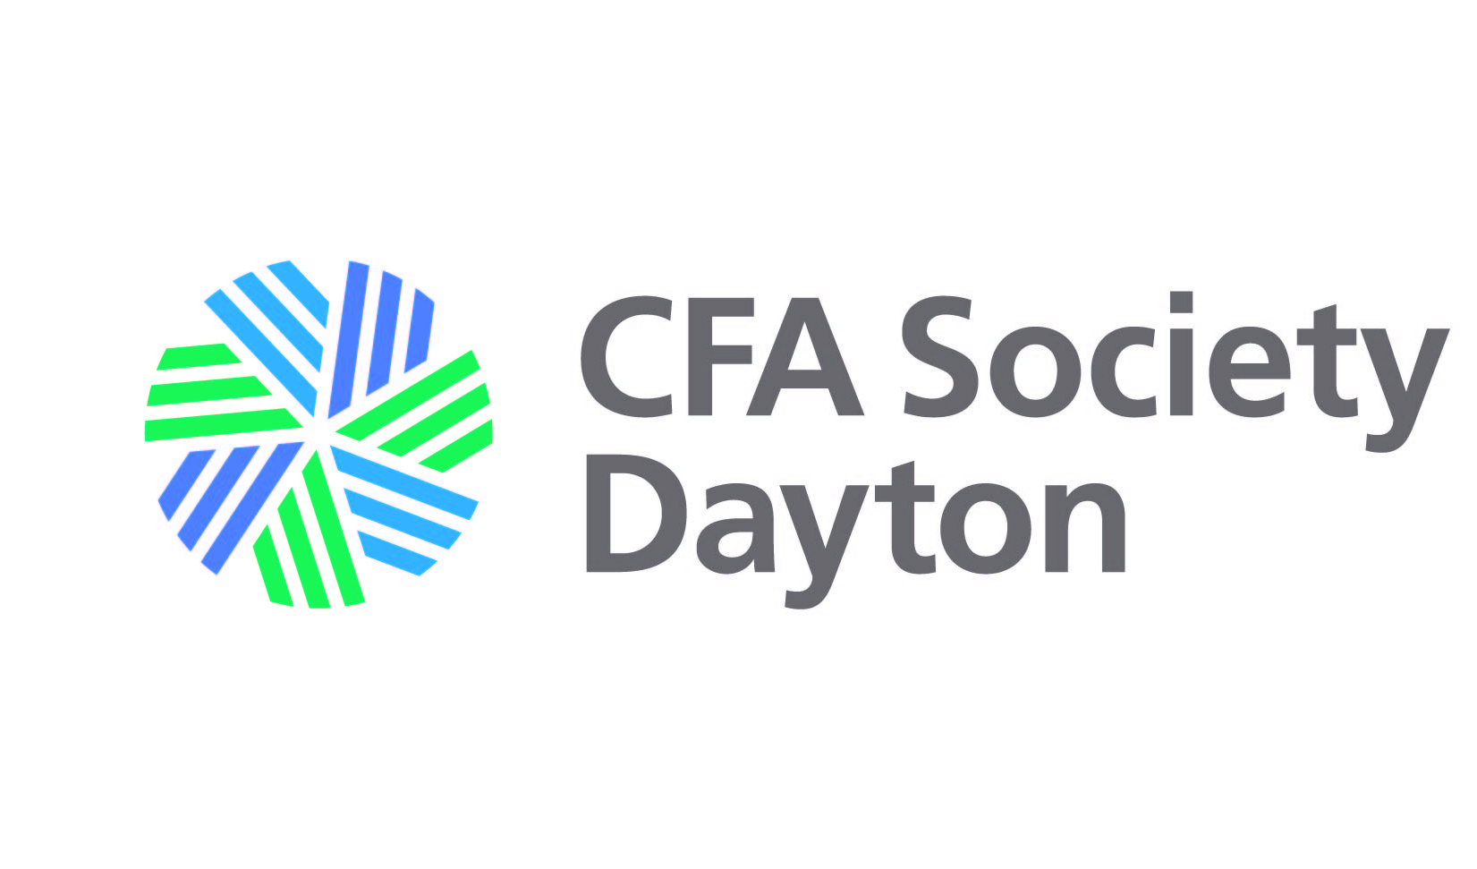
for more information:
CFA Society Dayton Webpage: https://www.cfasociety.org/dayton
CFA Society Dayton LinkedIn page:
https://www.linkedin.com/company/cfa-society-dayton
CFA Society Dayton Facebook page: https://www.facebook.com/daytoncfa
CFA Institute: https://cfainstitute.org/

Slide 25
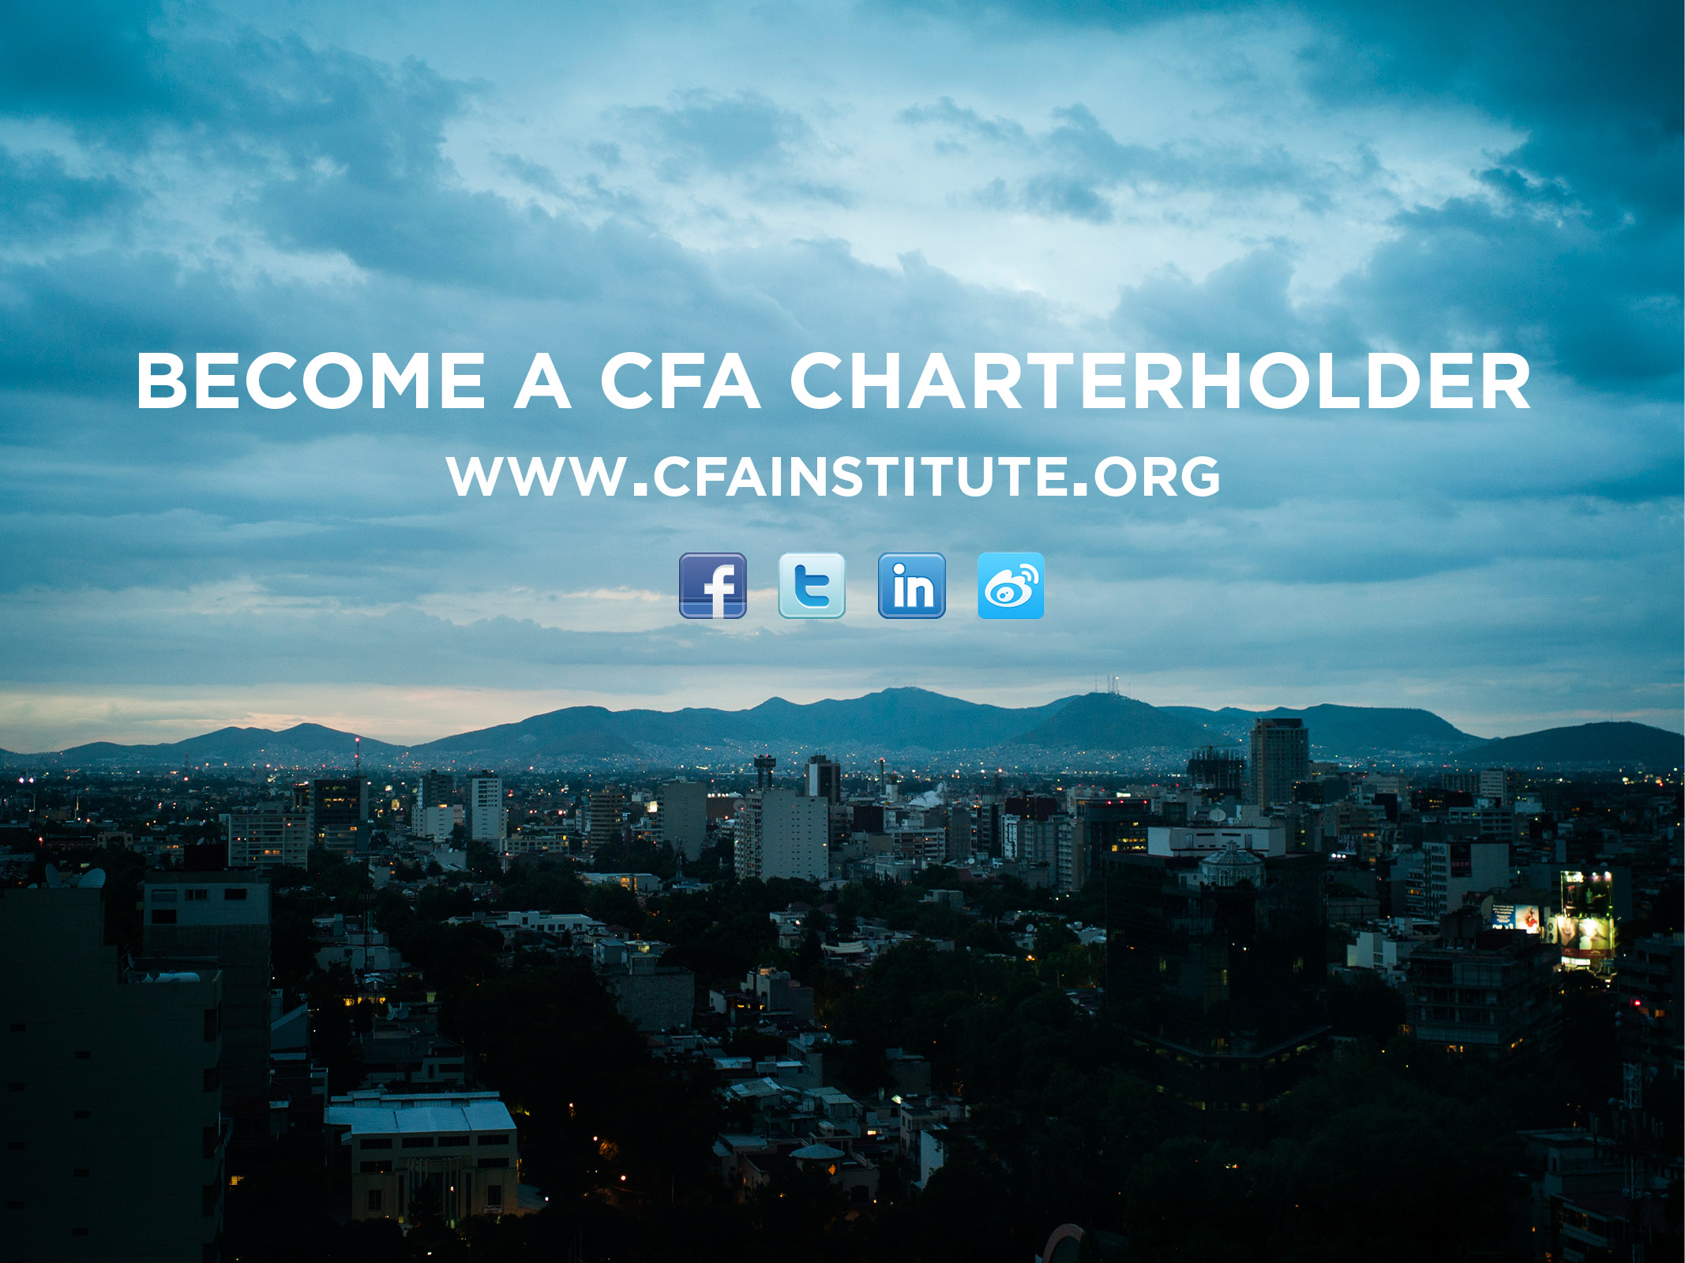
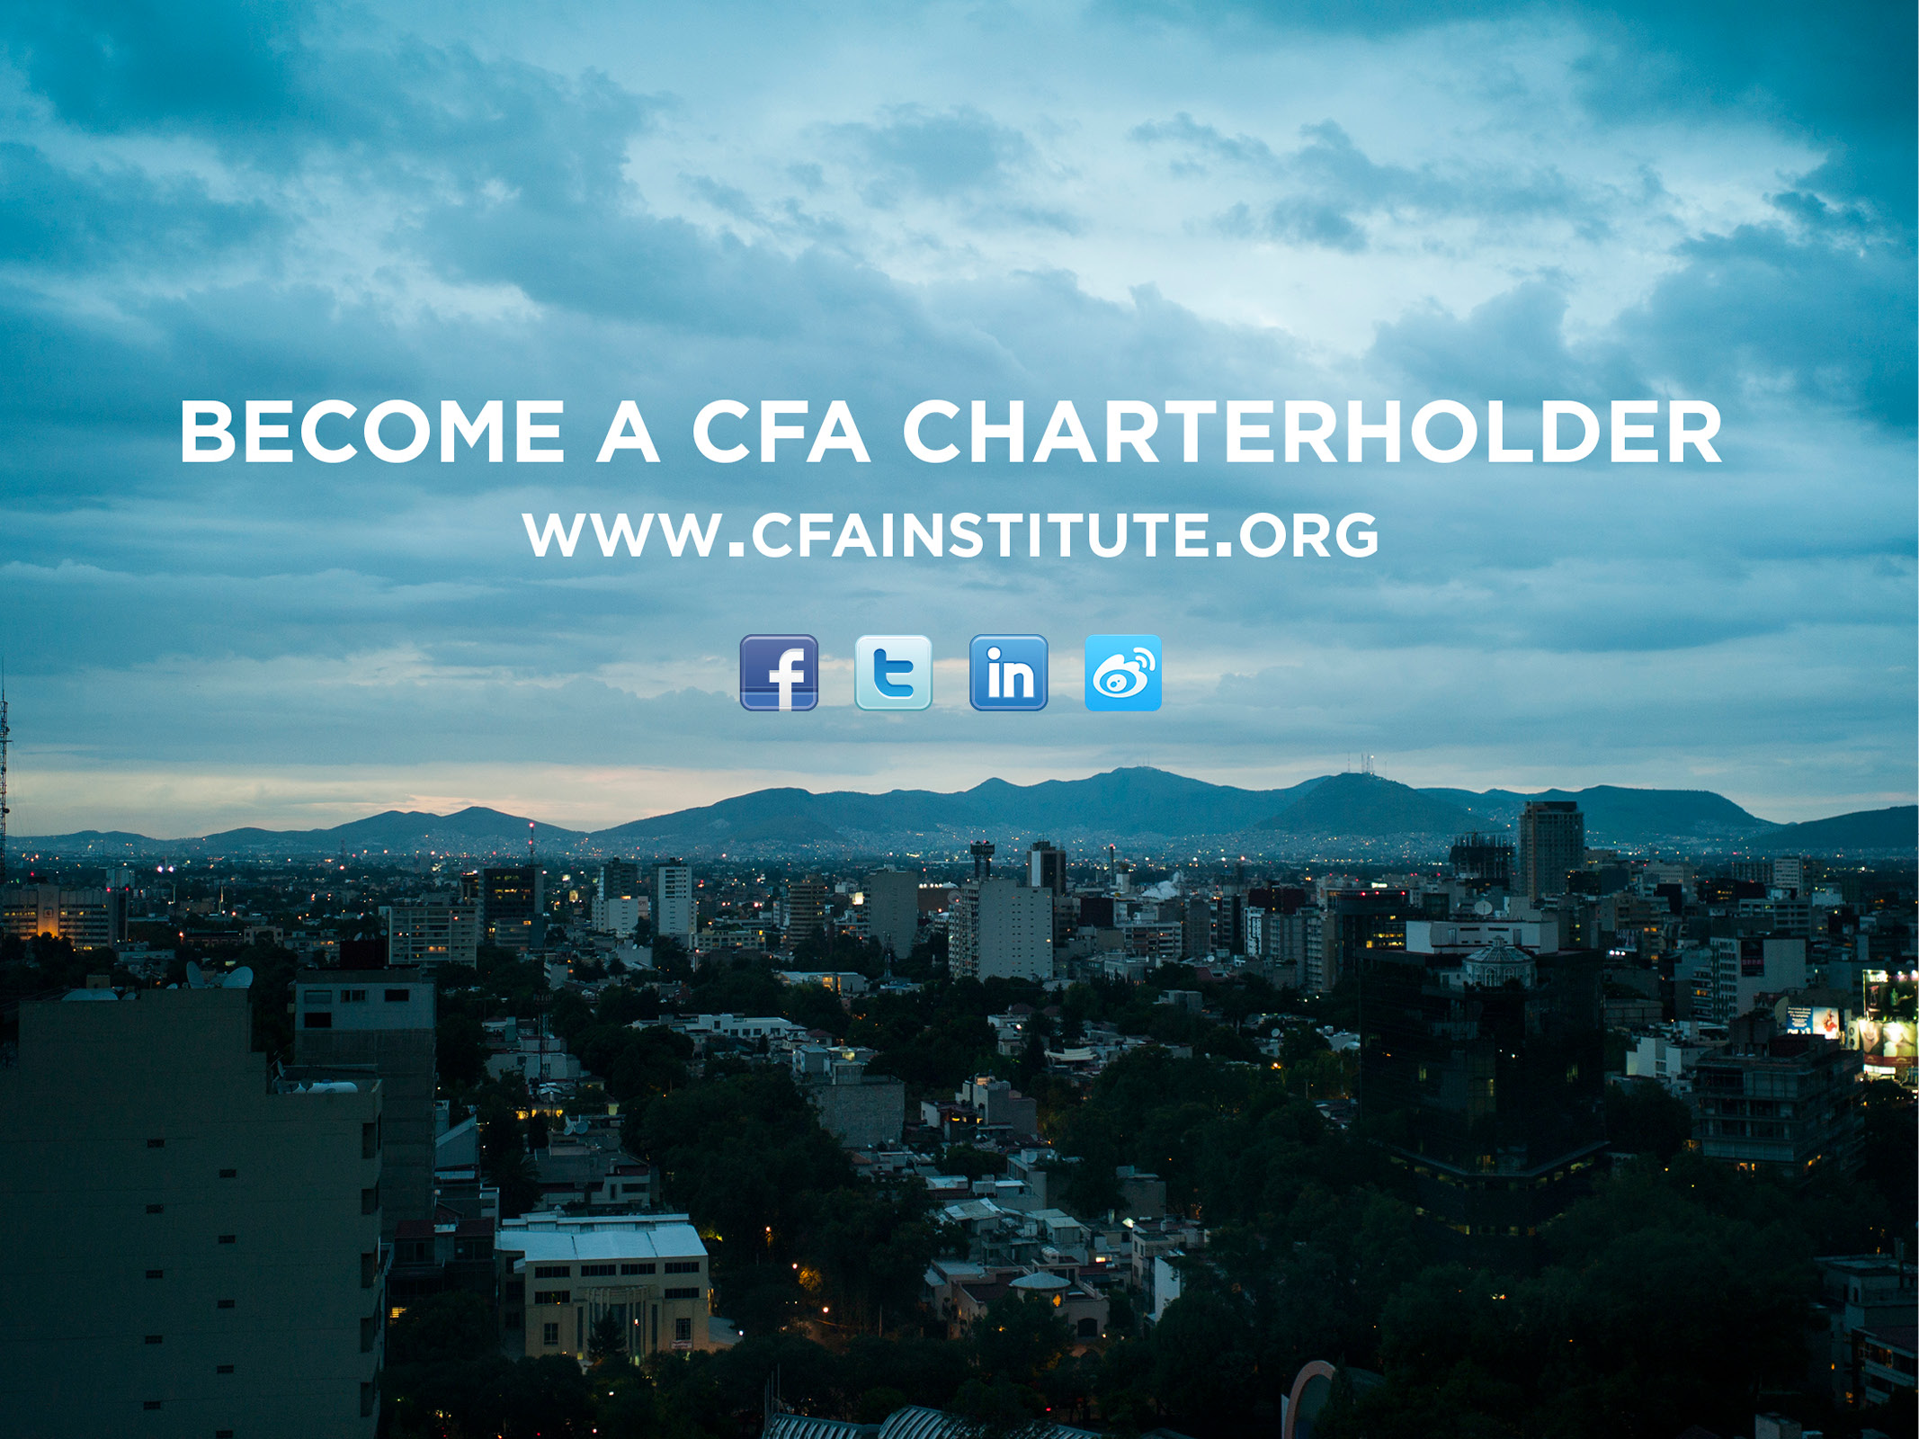
Notes:
To learn more about the charter and CFA Institute, I encourage you to visit our website for more information or to register.
I am also happy to answer any questions that you might have.
Thank you for your time.

